Slide 1

Genre

Slide 2


Last Time
We talked about some of the different philosophical positions your fields will build from (which affect what kind of evidence is considered acceptable).
We also talked about the difference between primary and secondary evidence.
We looked at Google scholar to determine top journals in your fields.
You started to look on the library website.

Slide 3
This Time
We are going to start to prepare for the first major assignment by continuing to look at the library and defining “Genre.”
Go to the LMS.
Click “Assignment Prompts”
Open “Genre Analysis.”

Slide 4

Groups: What is genre? Why do we use genres? What are some examples?

Slide 5
What is genre?
Come from structural and functional linguistics and new rhetoric (focuses on social and cultural contexts)
Genres are recurring kinds of texts.
Genres accomplish certain social tasks and goals within specific contexts. (invitations, parking tickets, textbooks, syllabi). They respond to recurring social situations.
Genres DO something in the world.
They have patterns that repeat across texts and can help you know where to look when reading texts and help you determine how to write your own texts.
They have observable conventions that you can replicate if you can pick them out. BUT, these conventions are NOT hard and fast rules.
You can think of them like “maps” that guide you, but you also need to know how to look at them.

Slide 6
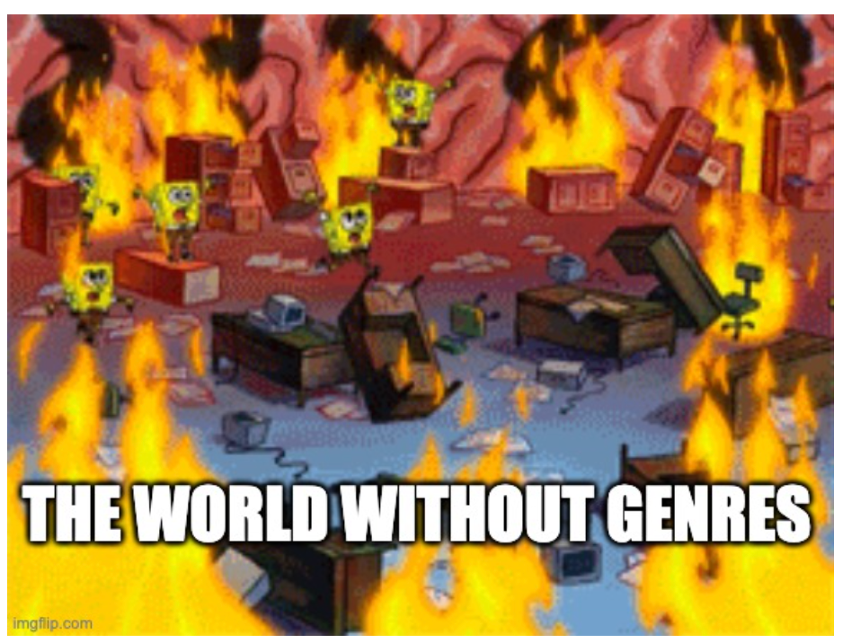
What if there was no agreed upon way to write a resume? Or a parking ticket?

Slide 7
Wait, why does genre matter for research writing?

Slide 8
Why?
Research writing also responds to recurring patterns and follows genre conventions.
If you can learn to analyze genre conventions of your field, you do not have to simply memorize a bunch of conventions, and you won’t be relying on me teaching you genre conventions from a field that may not be your own.
You can use genre analysis to ascertain much more about research writing in your field than I can teach you in a semester (even if this was a discipline-specific class).
You can also use genre analysis for any other kind of communication that you might need to do outside of this class.

Slide 9
Examples
Go to BB
Click on Week 2
Click down to today’s date and look at the links for genre analysis.
Pick out a few questions that you think will be helpful.
xUTEP:
https://www.utep.edu/uwc/the-writing-mine/articles/how-to-genre-analysis.html#:~:text=A%20genre%20analysis%20is%20an,using%20that%20genre%20to%20communicate
OWL Purdue:
https://owl.purdue.edu/owl/graduate_writing/documents/Questions-for-Genre-Analysis.pdf

Slide 10
UTEP: Basic
Purpose
What did the creator of the text want to achieve with it? Why was the text created? Did something prompt the creator to make the text? (helps define context).
Audience
The audience can be broad or specific.
“The general public” is not a good answer because people are different.
Structure
How is the text structured to help the author achieve the purpose for that audience?
Genre Conventions
What common features appear across these texts and how does that help the text achieve the purpose for the audience?

Slide 11
OWL Purdue: Global Features
Structure/Organization
What are headings and subheadings?
How is the text structured to develop an argument?
When are terms defined?
Audience
What can the audience already be expected to know (and how do you know)?
Where is the audience indicated and how (often implicit)?
Purpose
Where is purpose discussed and what are the “moves” in the introduction?
What are the “moves” in the other part of the paper and how do they support that purpose?
What is the author doing (as opposed to what is the author saying)?
Support/Evidence
What evidence does the author use to support their claims? (hint: this likely stems from their philosophical tradition).
How much context do they give? What kind of data is acceptable?
How is credibility indicated?

Slide 12
OWL Purdue: Sentence Features
Formatting
Quotations
How many are used and how long?
Citations
What is the style and how are they used?
Sentences/wording
How long are sentences?
When are abbreviations used?
when are field-specific words used and how are they defined?
What “signposting” language is used? (e.g., “In this section, I will...”)
How do authors indicate varying levels of certainty (e.g., “might indicate”)
What is the verb tense?
Is the voice active or passive (“Sample groups were arranged...,” “The researchers arranged sample groups...”
Do they use first-person at all?(e.g., “I did this,” vs. “the researcher did this”)
How formal is the tone and how can you tell?
Are there idiomatic expressions?

Slide 13
Practice
Go to BB
Click on Week 2
Click down to today’s date and look at the examples of types of texts with emails, instructions, encyclopaedia entry, nutrition labels, sports articles, video game reviews. (Number off).
Practice on whatever kind of text you are assigned with your own with the genre analysis worksheet.
In the Answer column, answer the question on the left.
In the “evidence” column, please provide evidence to support that claim.
So, that means finding a quote or describing what about the text shows you what the purpose of the text is, or who the intended audience is. Other quotes might be citing headings, quotes telling me what each section is doing, etc.
Feel free to deviate from the genre analysis worksheet; it is meant to be a guide, not rules.

Slide 14


Get With a Partner
Get with a partner who examined a different kind of text than you. Discuss what you found.
Be prepared to share with the class.

Slide 15
Genre Analysis paper
Congrats! You did a mini-version of your genre analysis assignment!

Slide 16
Genre Analysis Paper
Find 2/3 articles in your field. Look for evidence (quotes, etc.) to answer:
What key features characterize academic research writing in your field? How do these features fulfil the purpose of the document and respond to recurring situation of research writing in academic journals?
1
2
3
4
Recurring situation/purpose
Where do these articles appear and who is the audience in this journal? What is the purpose and what is the article doing?
Body/Argument
Global/rhetorical questions, content questions, sentence level questions.
Use evidence.
Connect back to the thesis.
Introduction.
Overview, signposting language.
Thesis about genre conventions
Conclusion
Recap what you told me.

Slide 17


Quick Write
Based on what we talked about with peer review, knowledge creation, etc. last time, what do you think the main purpose of most research writing in academic journals will be?

Slide 18
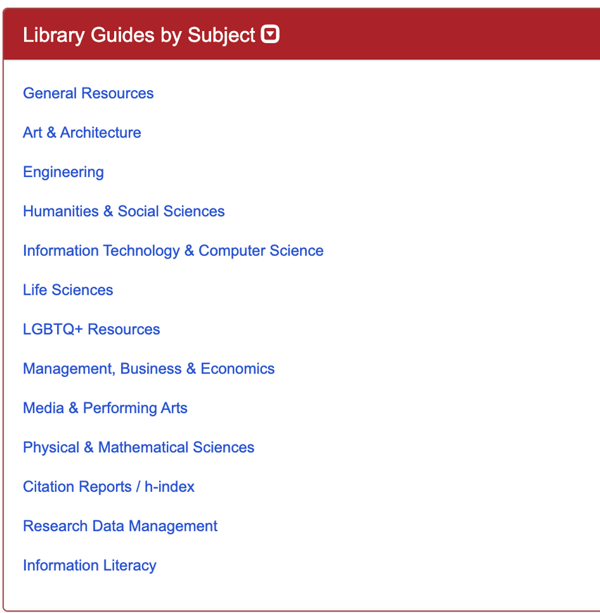
Recall...
Do we remember the “Finding Information” video from last time?
What did it say about using the library? Or, how do you currently use the library?

Slide 19

Using the Library: Basics
Go to: https://library.rpi.edu/
Start using the “Quick Search Tool” to find an article to analyze.
You can pick a journal that you identified as important in your field last time.
When picking an article, I suggest pick something you are curious about.
Avoid vague terms.
Use Boolean operators (e.g. AND/OR) that tell the search engine how to handle your search terms.
“Quotes” group phrases together.

Slide 20
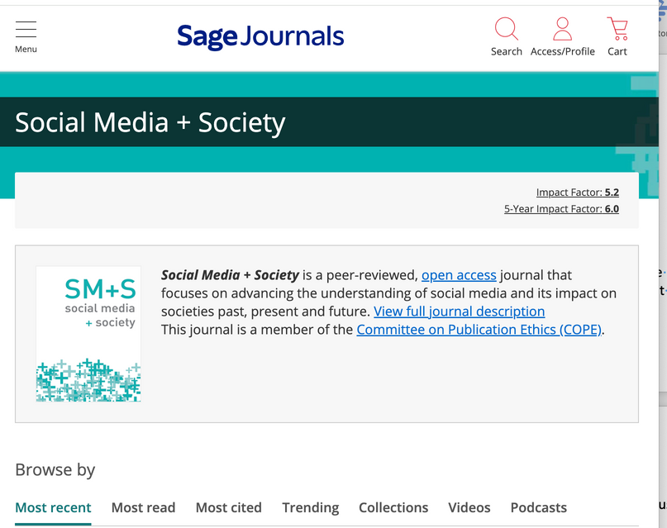
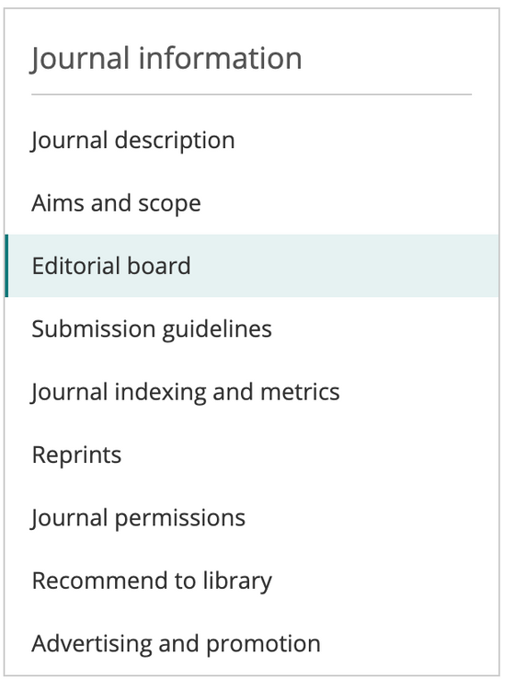
Quick Write:
Who is the audience?
Go to the journal’s home page (sometimes accessible through the library, sometimes, just use a search engine).
Find the “journal information” section.
Click on “Journal description,” “Aims and Scope,” “Editorial Board,” and “Submission guidelines.”
Audience 1: Journal description and Aims and scope will tell you about the readers of the journal (e.g., is it interdisciplinary? Who is their target audience?
Audience 2: Editorial board will tell you about who is making the decisions about manuscripts that are submitted. What fields are they in?
Submission guidelines tells you rules for authors.

Slide 21
Start to find articles for your genre analysis assignment.

Slide 22


Next Time
Keep finding articles for your genre analysis. I suggest sticking with the same journal and finding topics you are interested in.
Watch:
Choosing a topic and Avoiding Plagiarism
Read:
Quotes_Paraphrases_Summaries (in BB).
Citation Politics (also in BB).

